Slide 1

Quantum Information and Computing
2021 - 2022
Saverio Monaco
28/11/2021
Solution of the Time Independent
Schrödinger Equation for
an harmonic oscillator

Slide 2
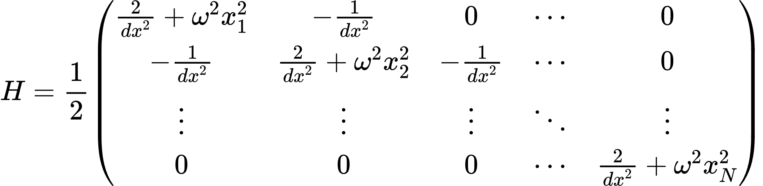
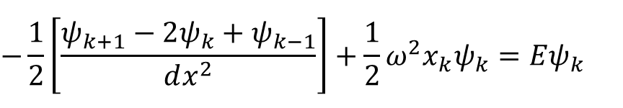

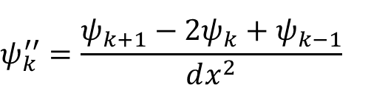
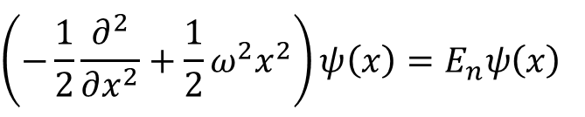


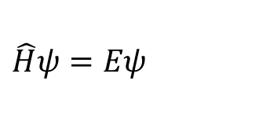
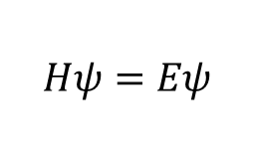
Theory
$\hat{H}={\hat{p}}^{2}+{ω^{2}\hat{x}}^{2}$ where $ℏ≡m≡1$
$$\left(−\frac{1}{2}\frac{∂^{2}}{∂x^{2}}+\frac{1}{2}ω^{2}x^{2}\right)ψ\left(x\right)=E_{n}ψ\left(x\right)$$
$$\hat{H}ψ=Eψ$$
$\hat{p}→−iℏ∂/∂x$, $\hat{x}→x$
$$ψ_{k}^{′′}=\frac{ψ_{k+1}−2ψ_{k}+ψ_{k−1}}{dx^{2}}$$
$$−\frac{1}{2}\left[\frac{ψ_{k+1}−2ψ_{k}+ψ_{k−1}}{dx^{2}}\right]+\frac{1}{2}ω^{2}x_{k}ψ_{k}=Eψ_{k}$$
$$≡$$
$$Hψ=Eψ$$
Notes:
Explain very briefly the theory you have based your solution on

Slide 3
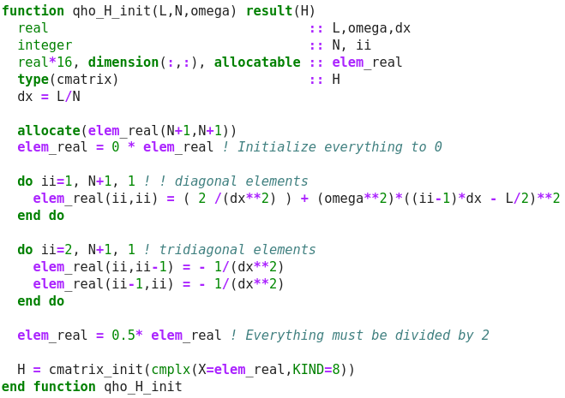
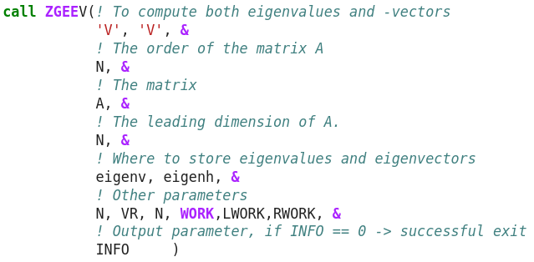
Code Development
qho_H_init() in module qho:
Initialize the complex matrix to
represent the hamiltonian of the
system given L and N
ZGEEV() function in
LLAPACK library:
For eigenvalues and eigenvectors
Notes:
Introduce strategies, tests, and report debugging problems, compilation options

Slide 4
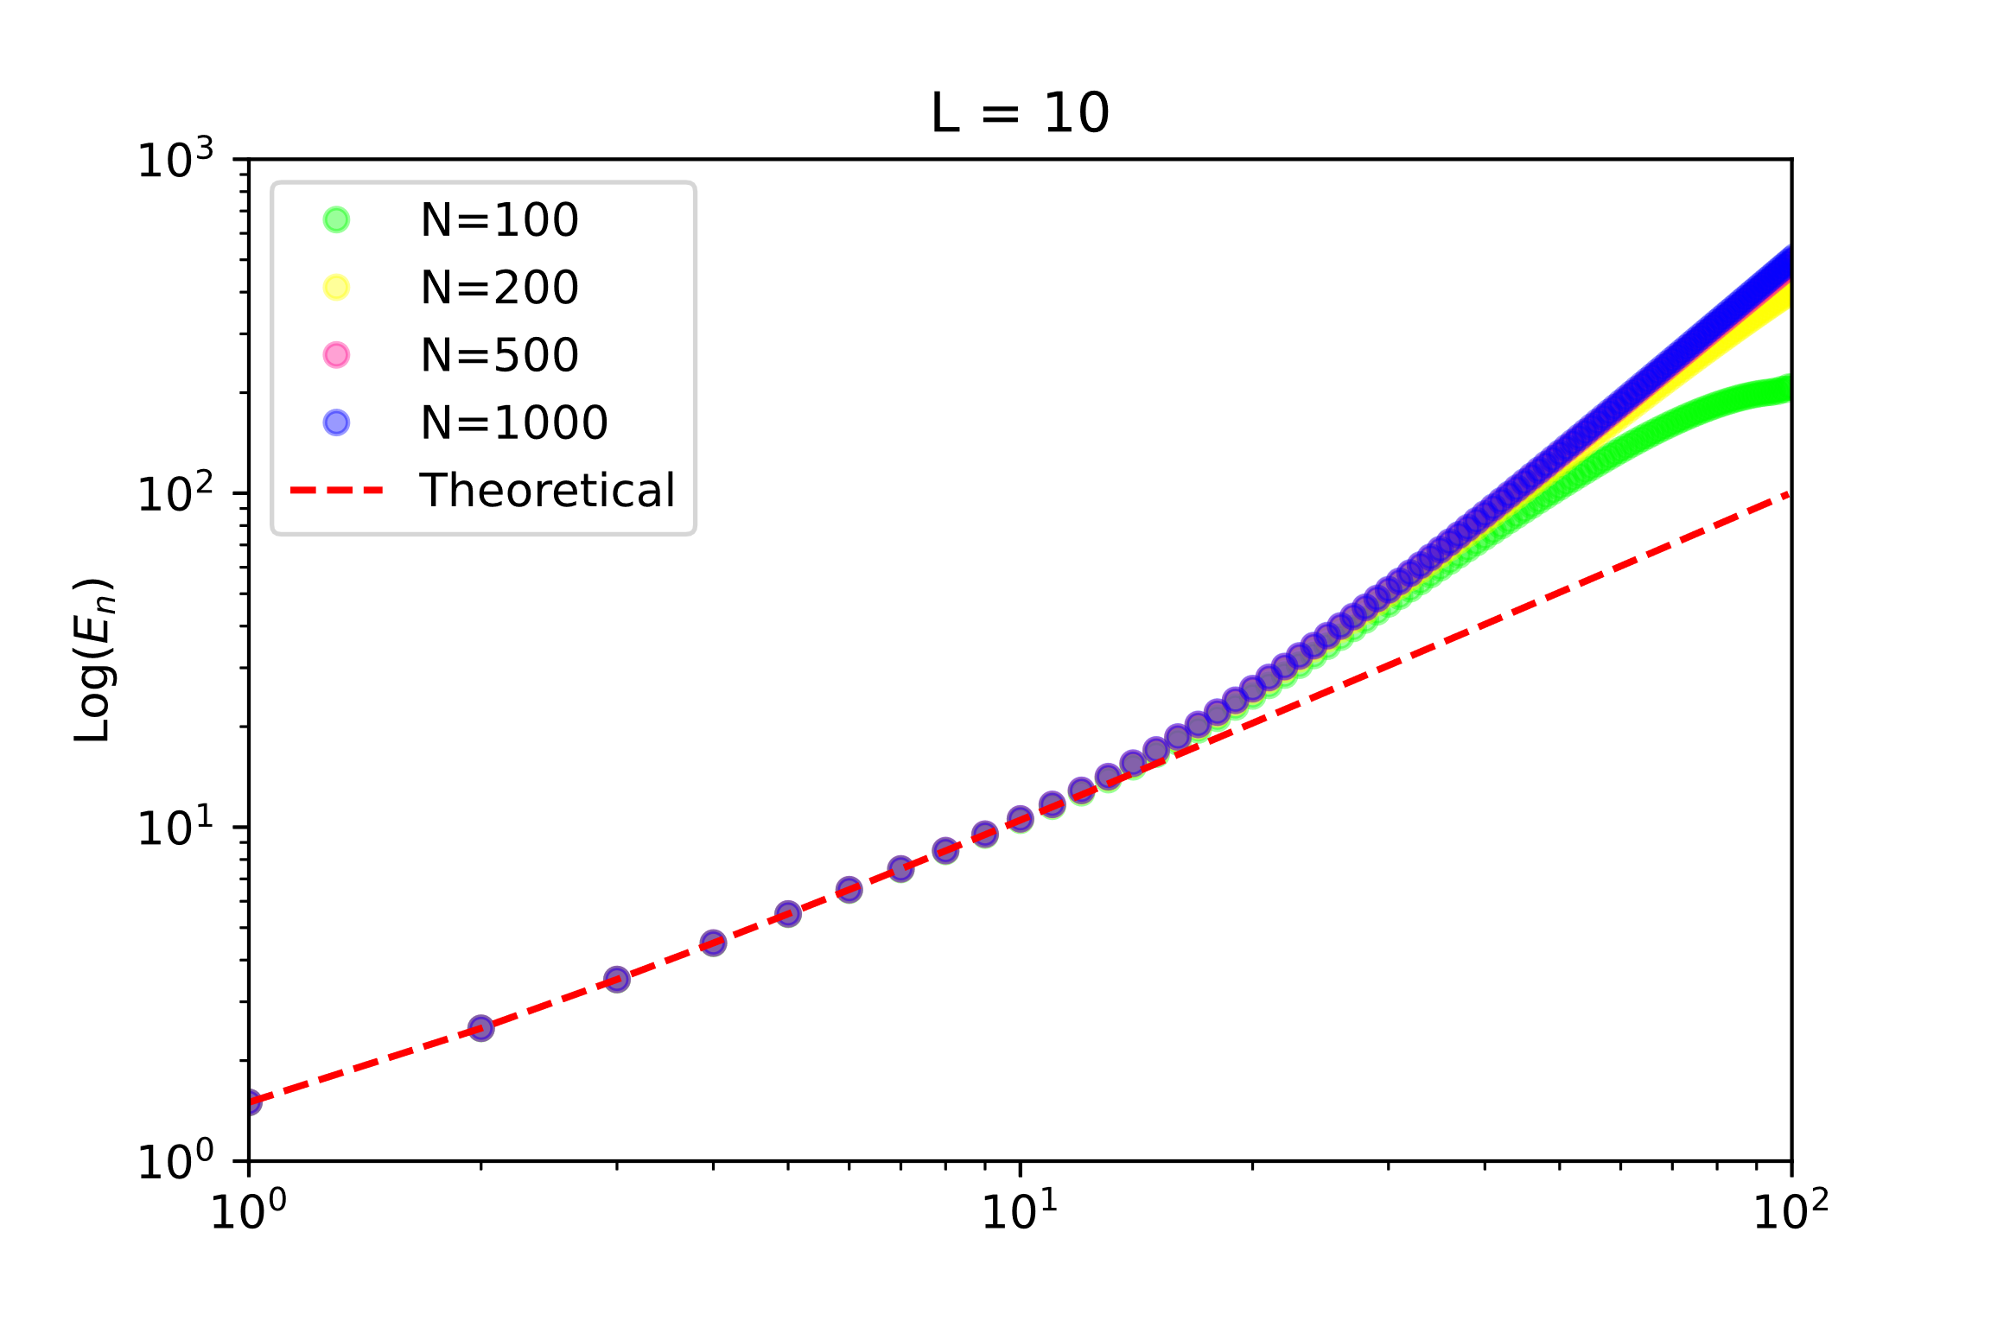
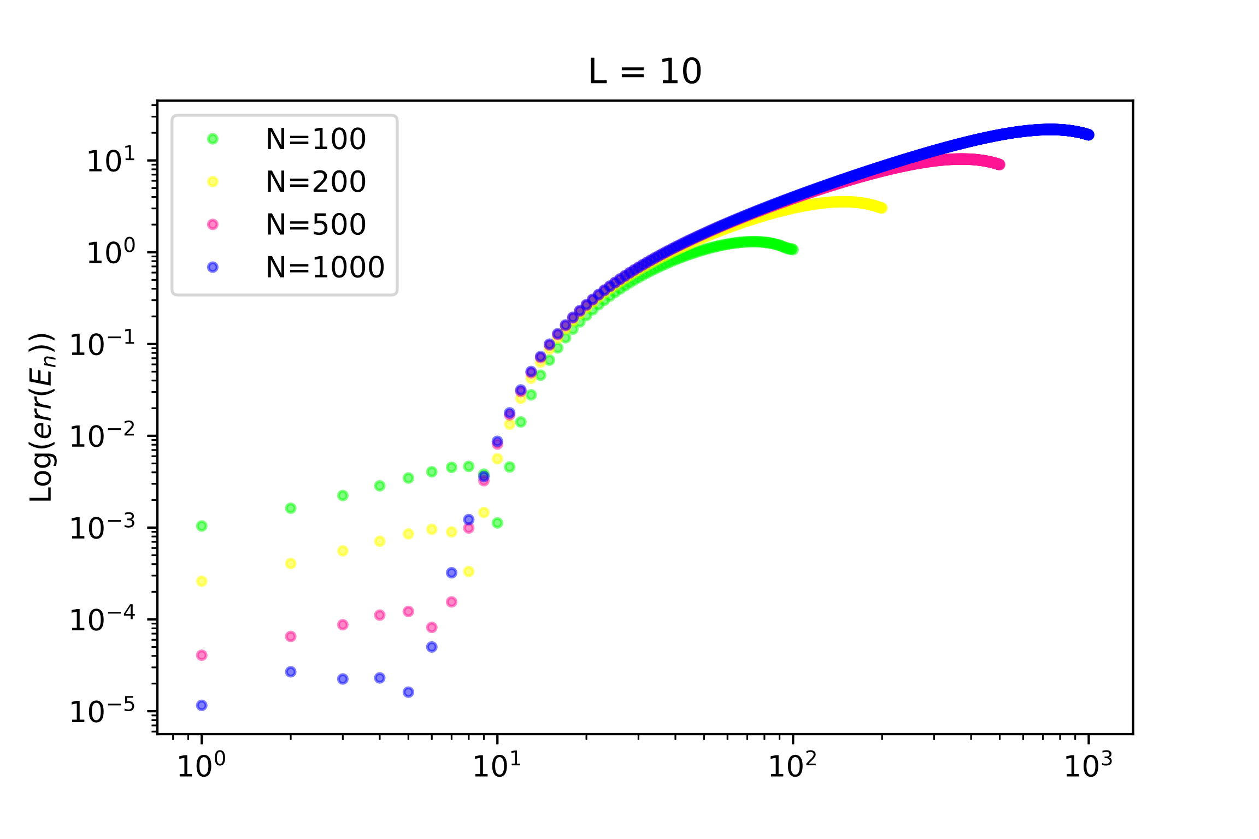
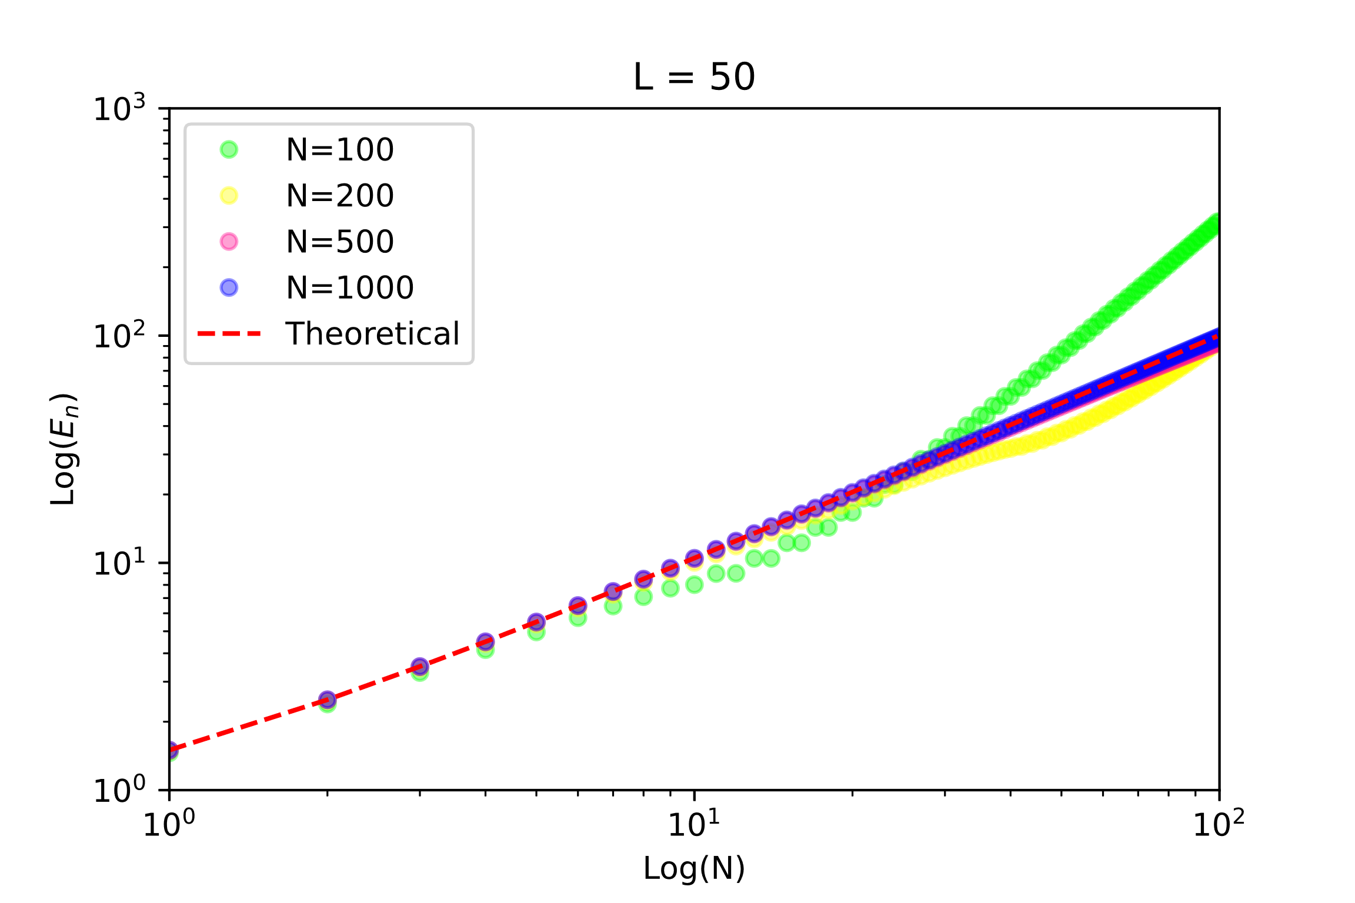
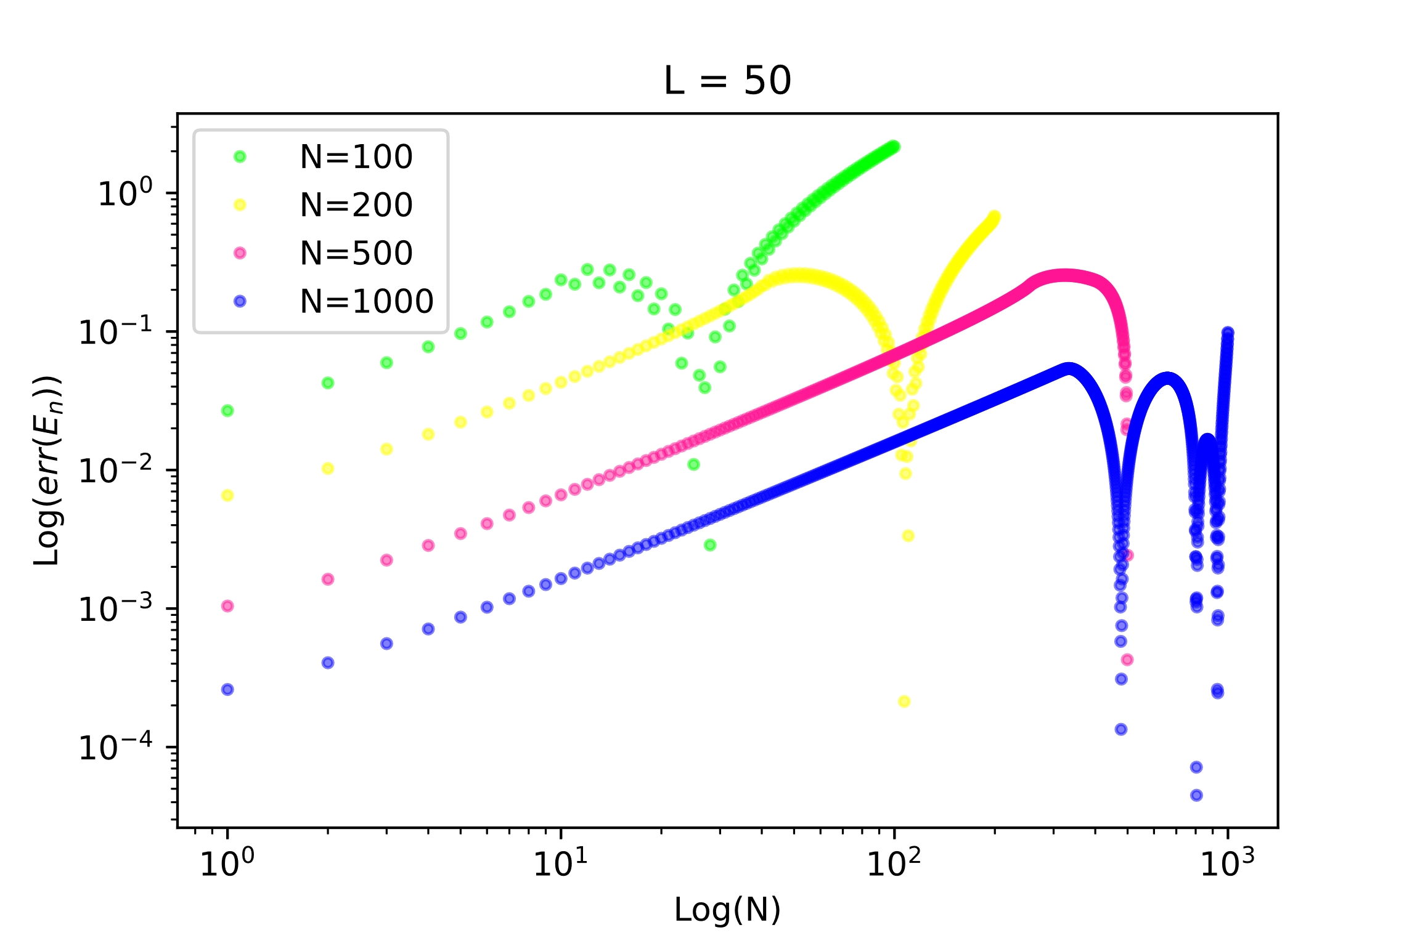

Results
$$err\left(E_{n}\right)≡\frac{|E_{n}−E_{n}^{true}|}{E_{n}^{true}}$$
Notes:
Present data and explain your results

Slide 5
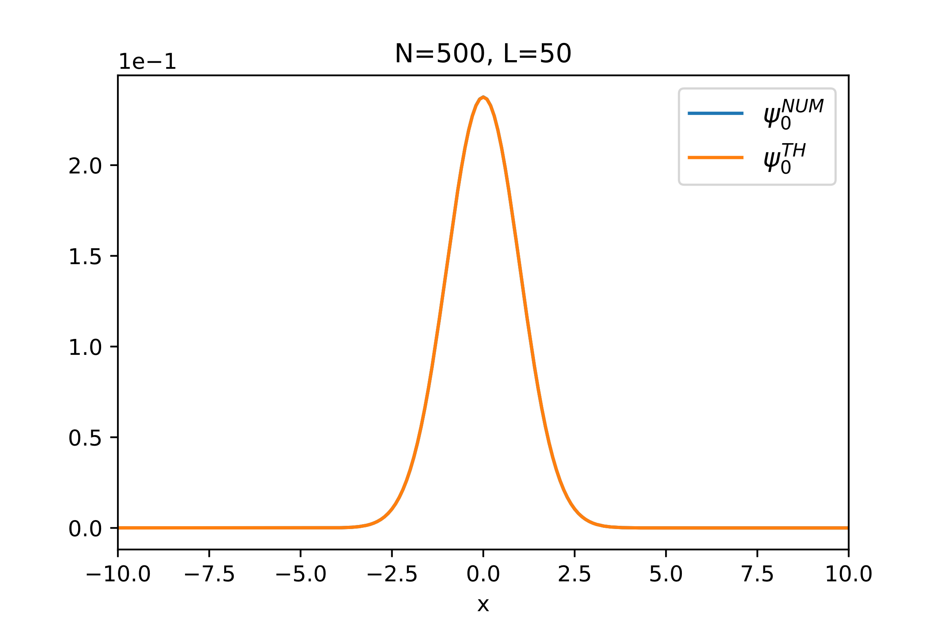
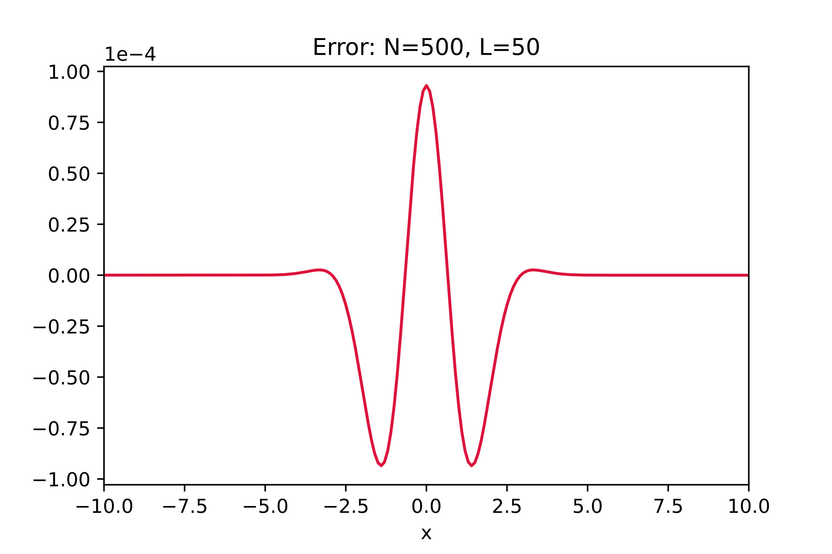
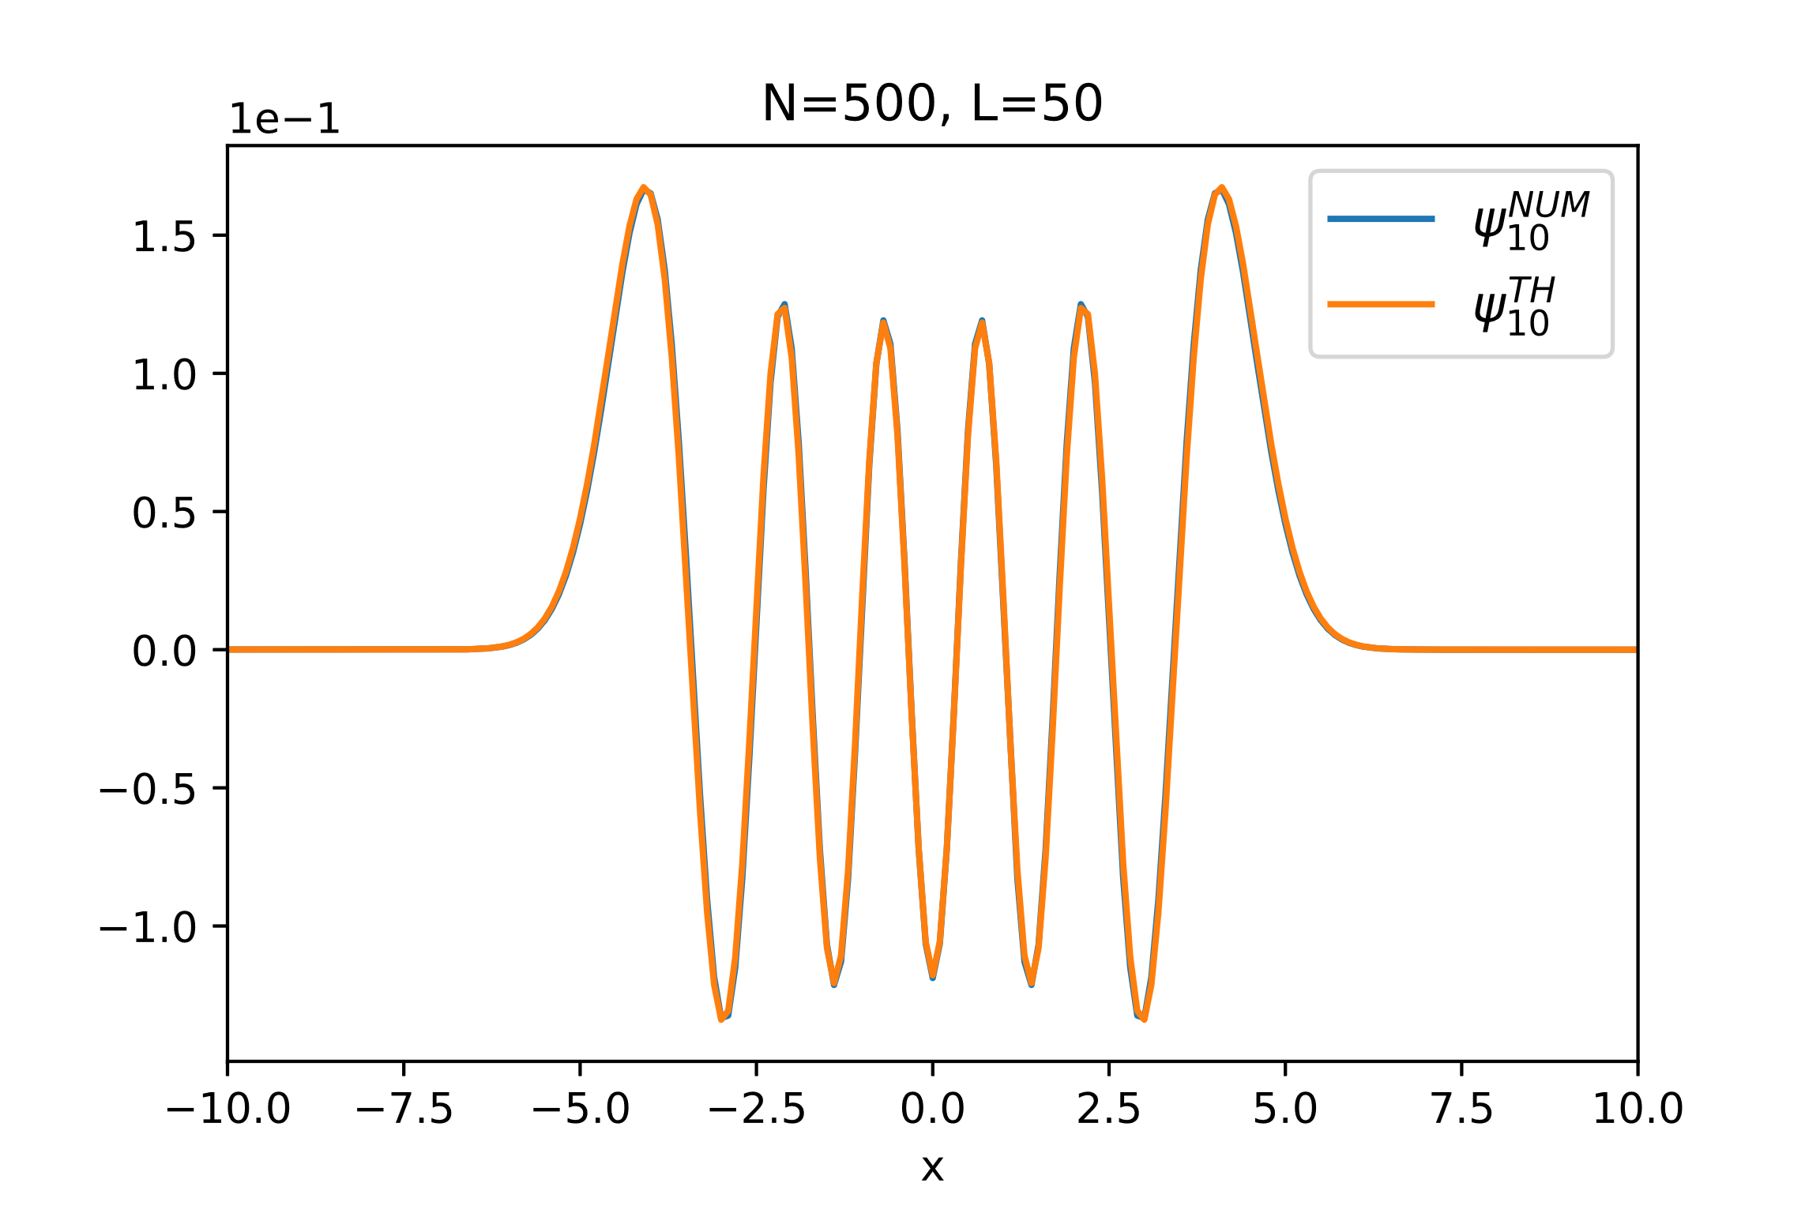
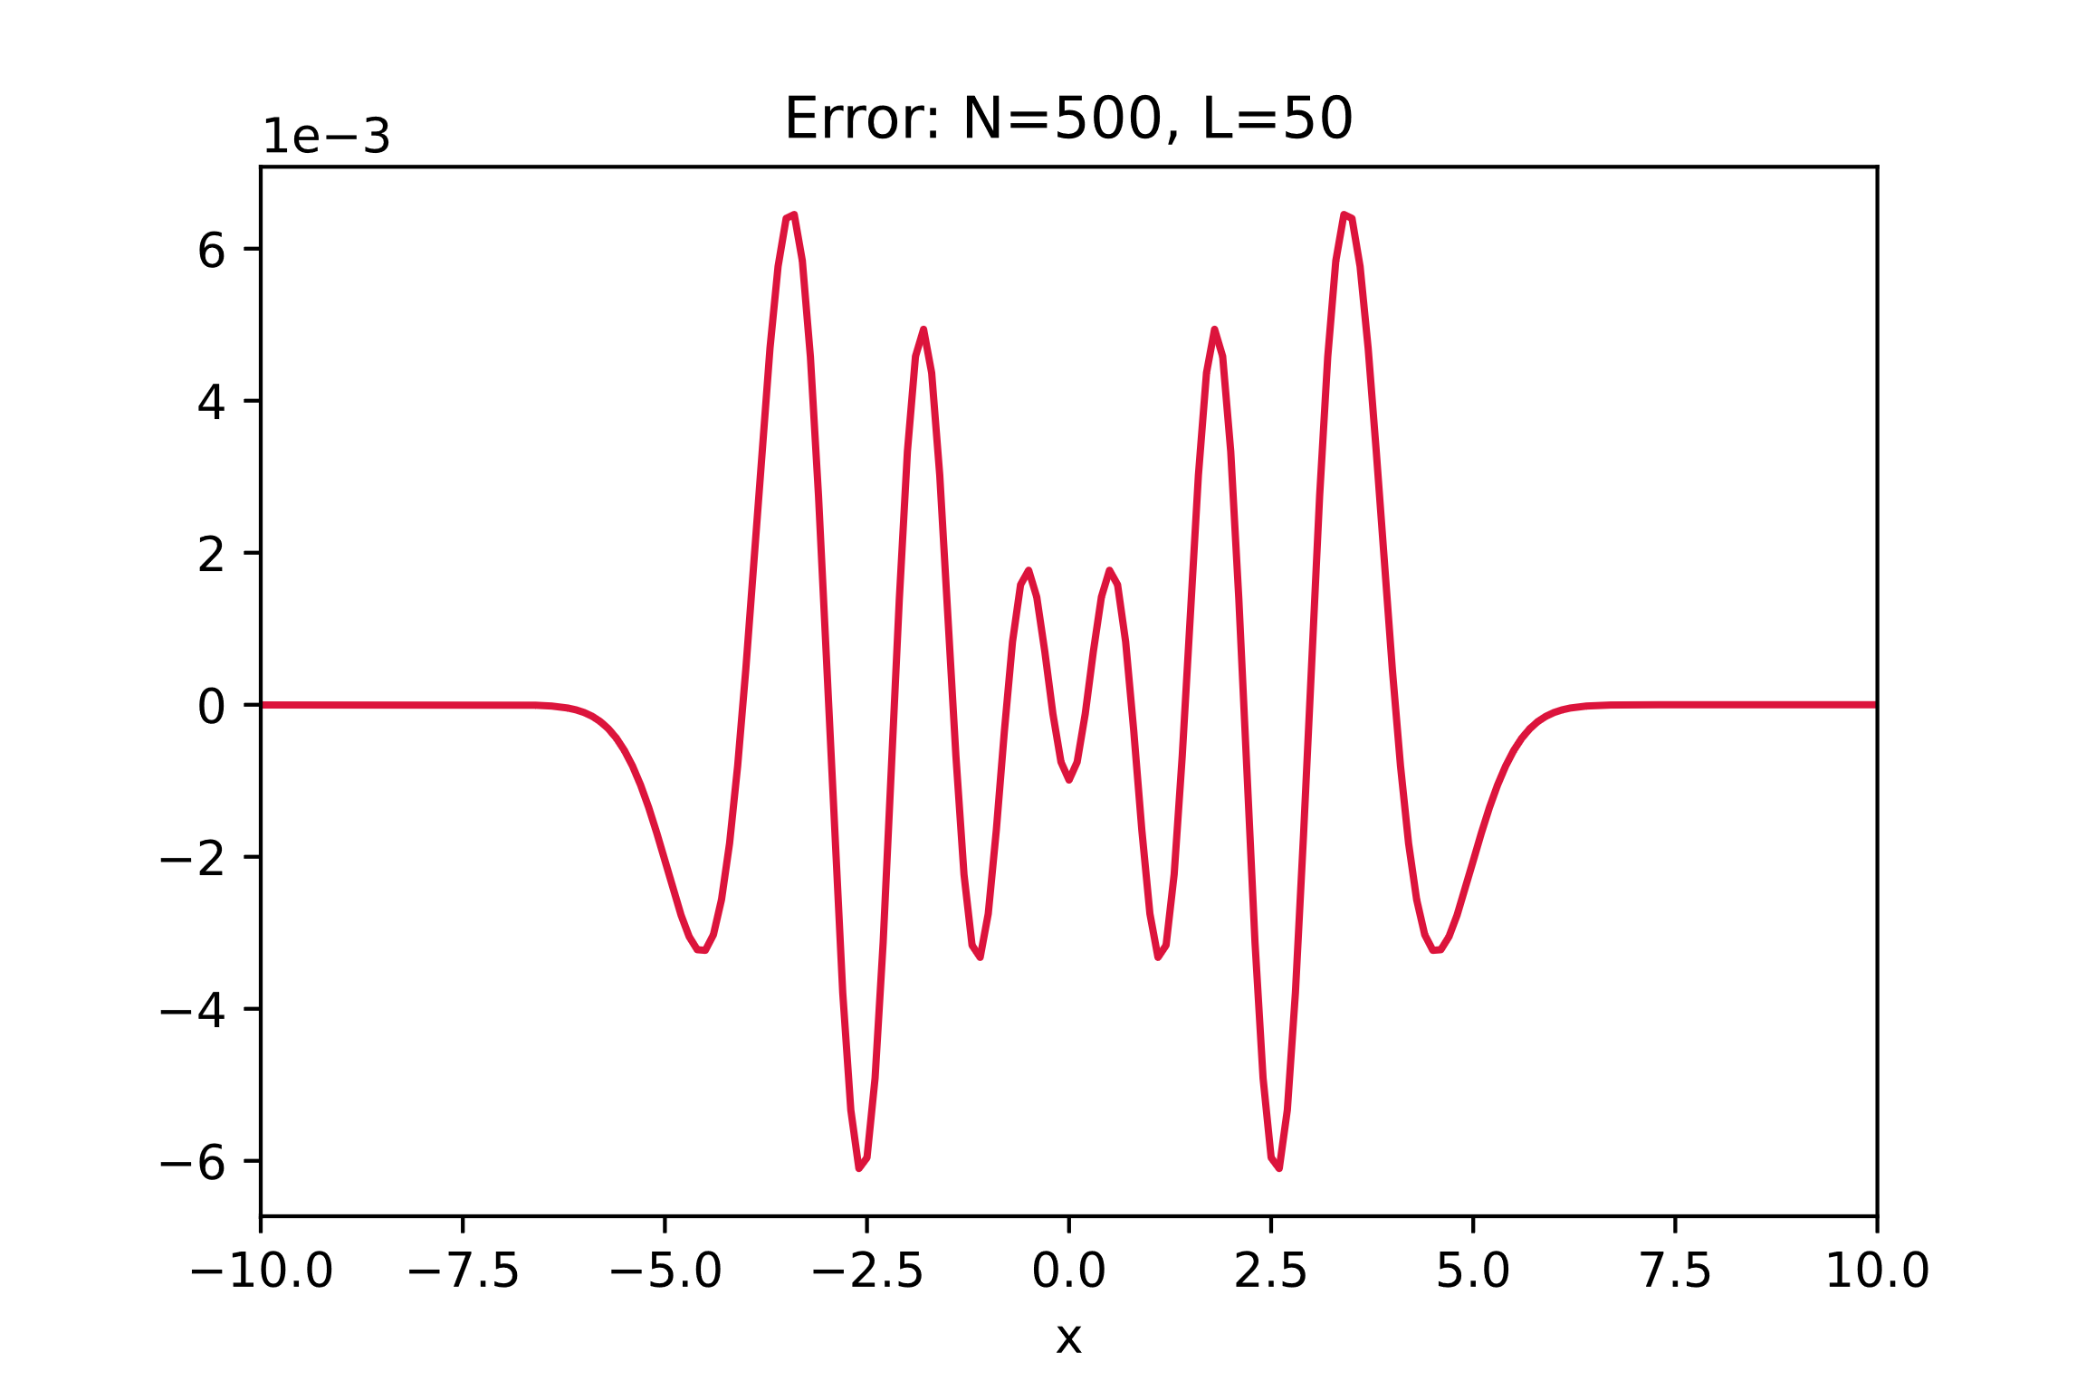



Results
$${err≡ψ}_{i}^{num}−ψ_{i}^{th}$$
$$n=0$$
$$n=10$$
Notes:
Present data and explain your results

Slide 6
Self evaluation
Correctness: Hugely depends on the choice of the parameters. It can
be still improved by using a better formula for the derivative
Stability: Various checks have been implemented to make the program
as stable as possible
Accurate discretization: For the right parameters (for example
L=50 and N=1000) the programs gives
accurate results
Flexibility: Based on ZGEEV and not DSTEMR for generalizing to
other problems
Efficiency: Can be improved by considering DSTEMR and real-only
matrices
Notes:
Present data and explain your results

Slide 7
Thanks for the attention
___________________________

